Slide 1
University Library
Simulation Project

Slide 2
Table of Contents
02
01
03
04
Student Arrival
Break and Lecture Period Arrival
Data Collection
Process Flow
Data Excel File
Shopping and Printing
Arena Simulation Model

Slide 3
Data Collection
01
Data Excel File

Slide 4
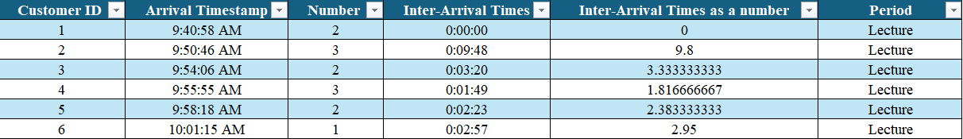
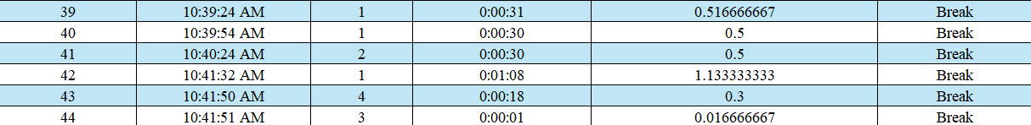
Collected Data Points:
Arrival Time: Exact timestamp of each arrival.
Service Time: Start and End.
Activity Type: Categorized as either Printing or Shopping.
Walking Time: Difference in time of walking from the door to the cashier.
Shopping Time: Difference in time from starting shopping to ending shopping.
Time Period: Specified as either during a Lecture or Break.

Slide 5
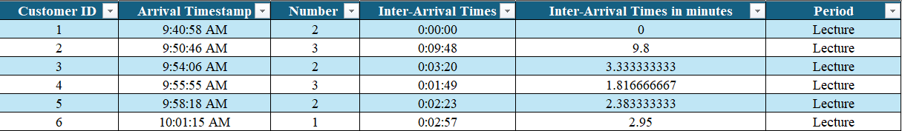

Arrival Time Data Collection

Slide 6
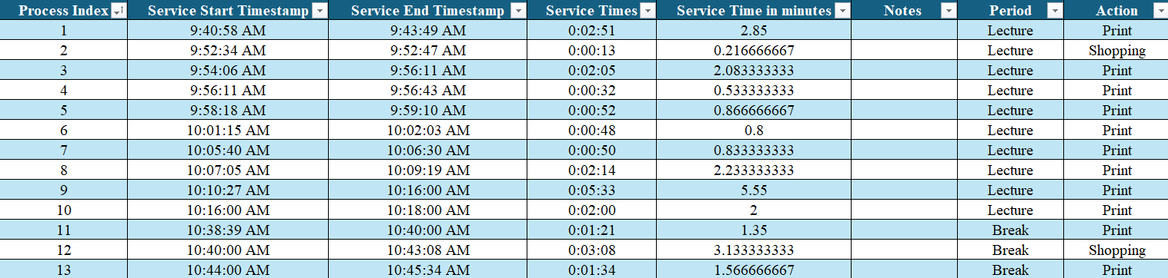
Service Time Data Collection

Slide 7
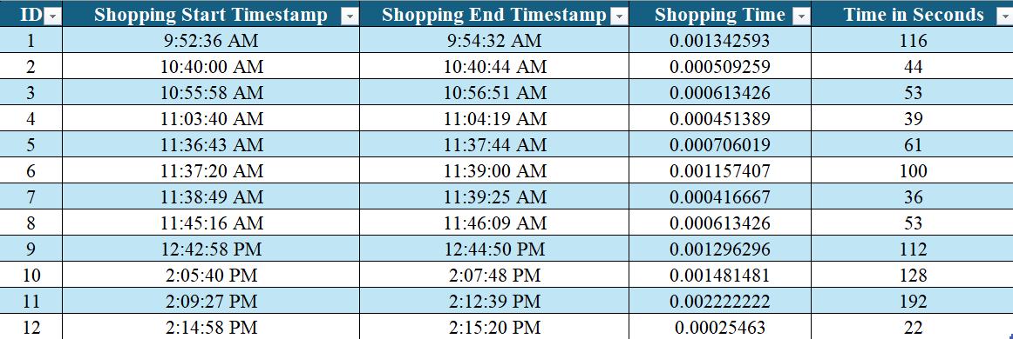
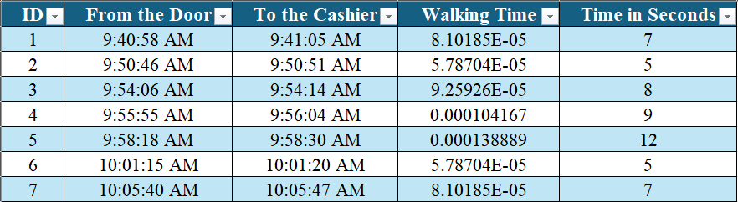

Slide 8
Table of Contents
02
01
03
04
Student Arrival
Break and Lecture Period Arrival
Data Collection
Process Flow
Data Excel File
Shopping and Printing
Arena Simulation Model

Slide 9
02
Student Arrival Analysis
Break and Lecture Period Arrival

Slide 10
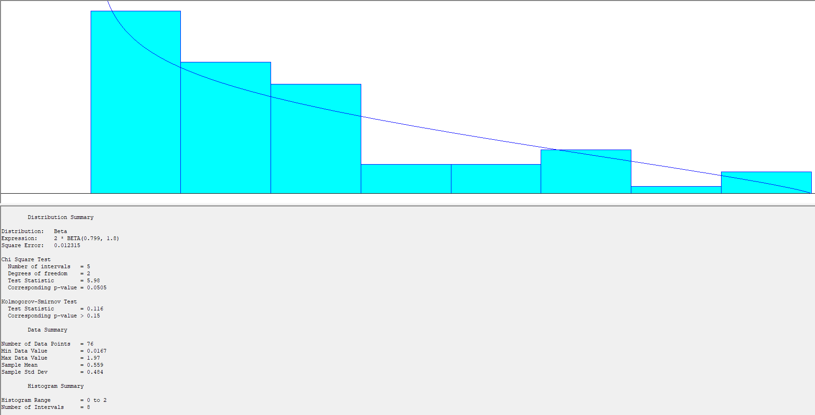
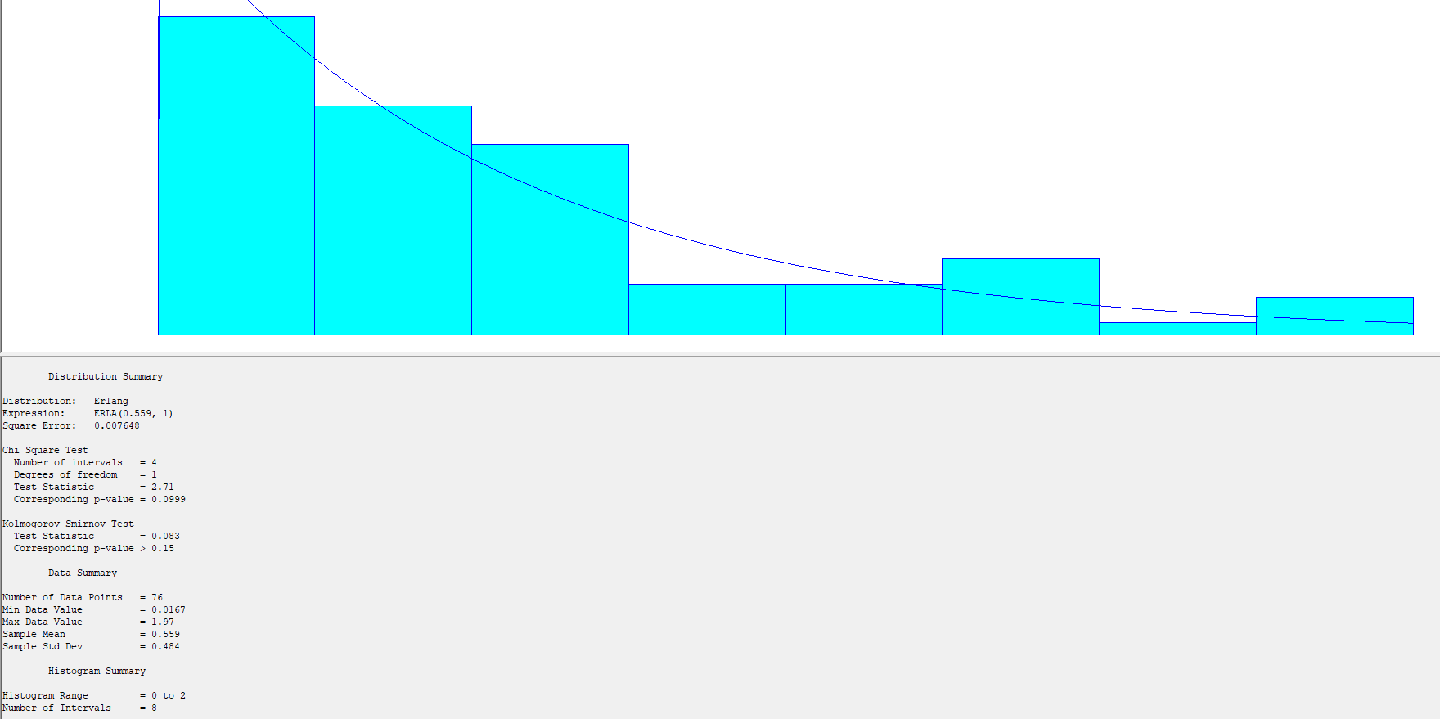
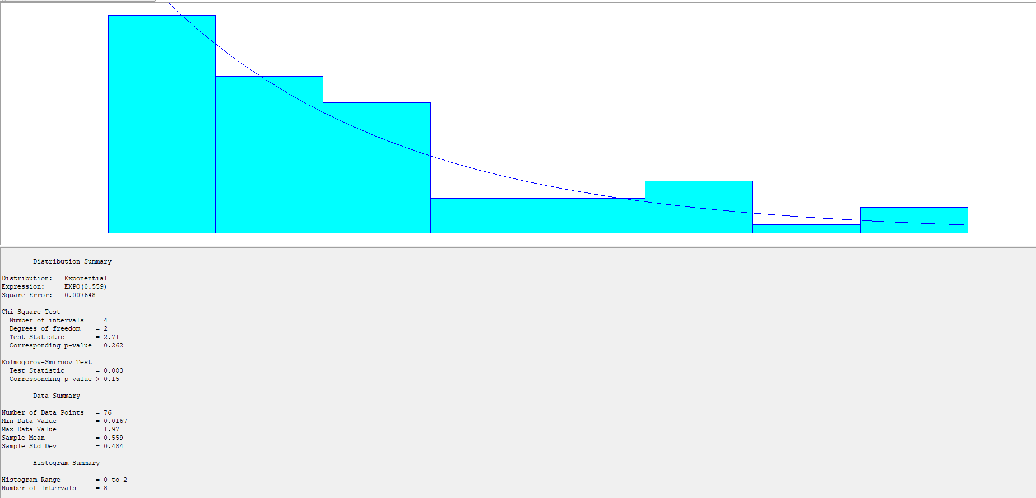
Arrival Pattern
Data was collected during the whole shift in the university library on Wednesday during lecture and break time.
Break periods experience higher arrival rates creating a rush-hour effect.
Student arrival depended on the break periods.

Slide 11
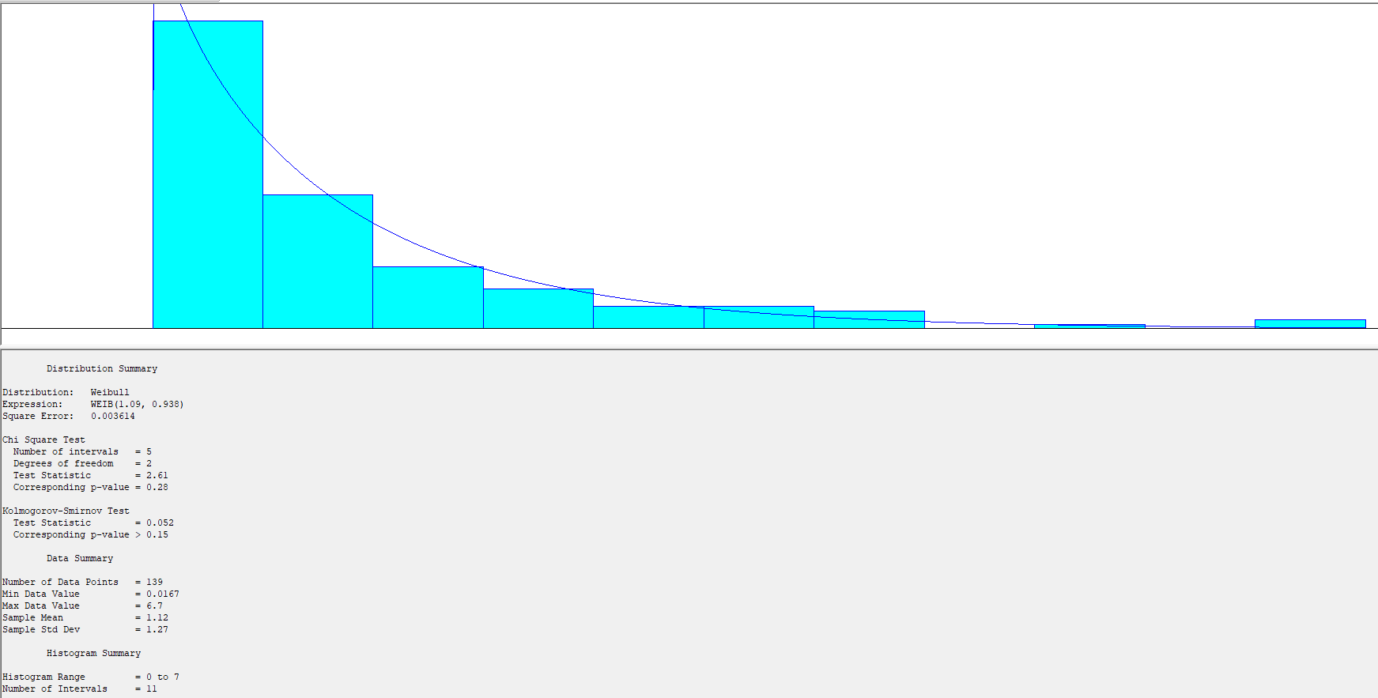


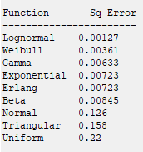

Arrival Distribution without Subsetting (Best Fit)

Slide 13
Arrival Break Distributions

Slide 14



Slide 15
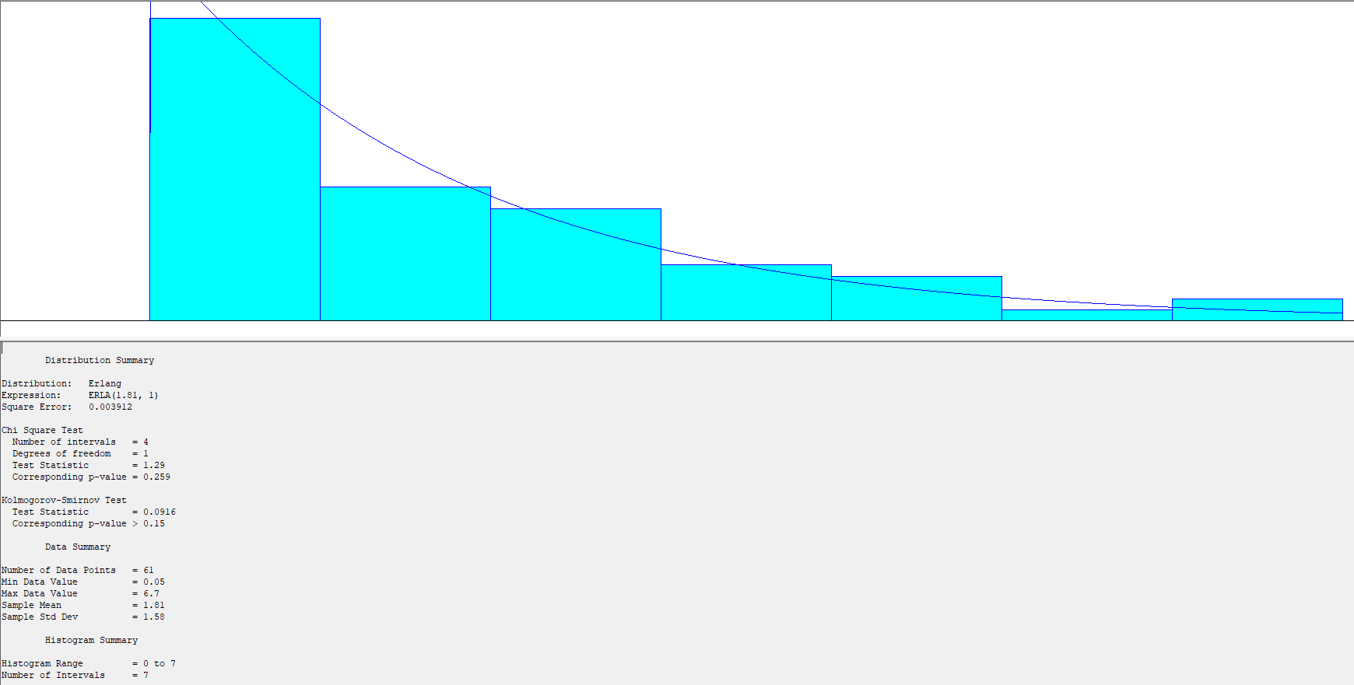



Best Fit in Arrival (Gamma)

Slide 16
Arrival Lecture Distribution

Slide 17
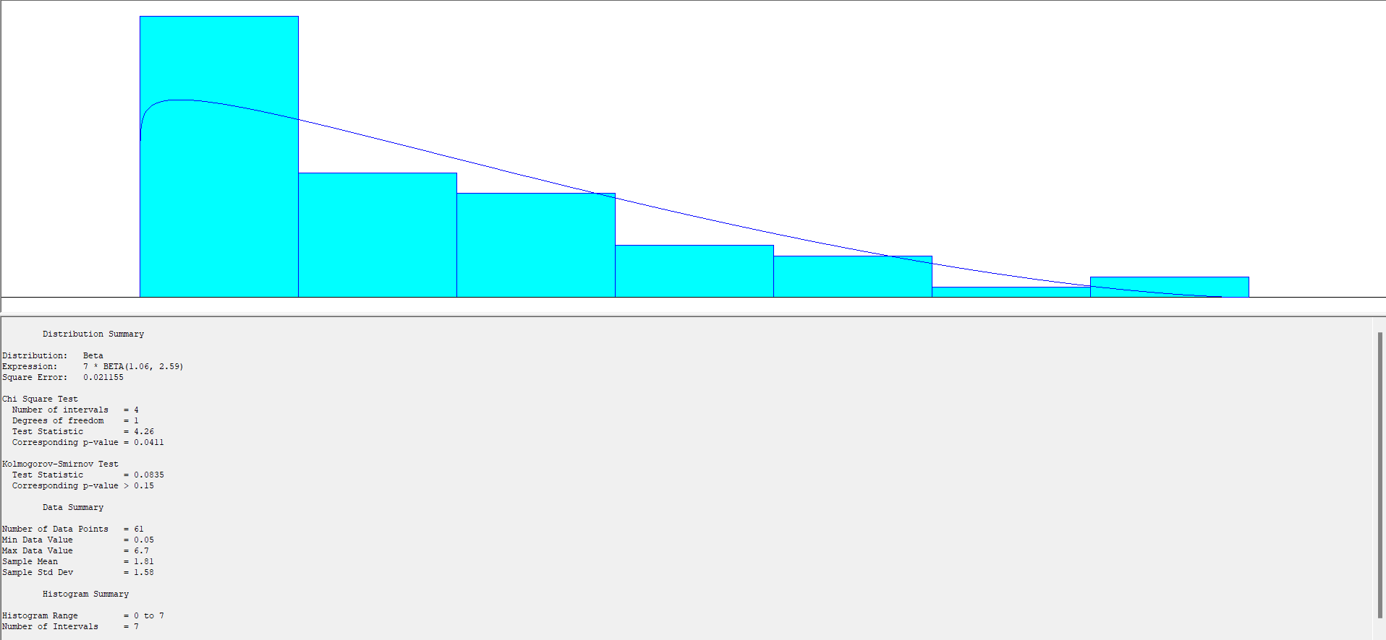
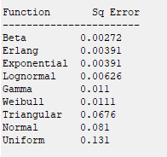
Best Fit Arrival
(Beta)

Slide 18
Table of Contents
02
01
03
04
Student Arrival
Break and Lecture Period Arrival
Data Collection
Process Flow
Data Excel File
Shopping and Printing
Arena Simulation Model

Slide 19
03
Process Flow
Shopping and Printing

Slide 20
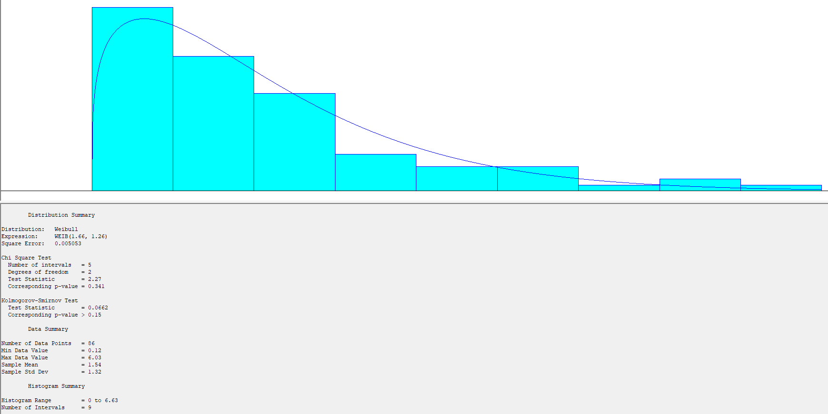
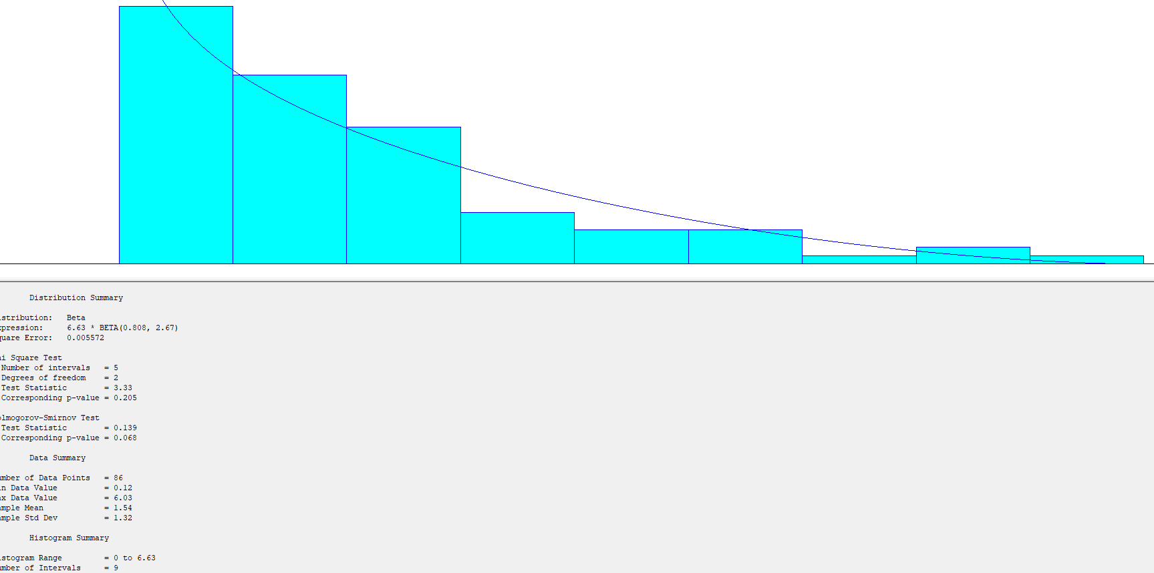
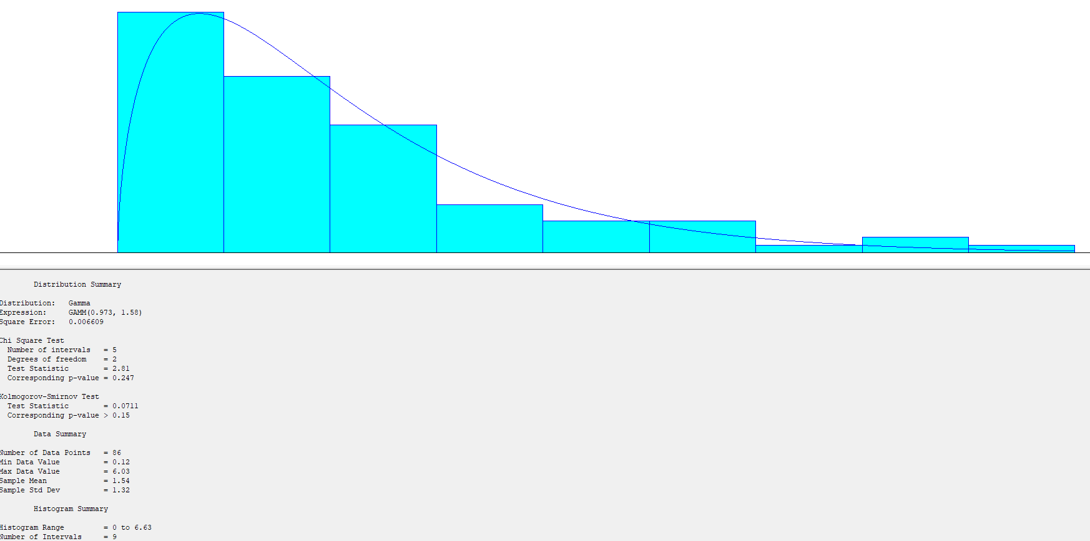
Shopping Process: Involves selection and purchasing of items.
Printing Process: Focuses on document preparation and printing tasks.
Resource Utilization: a single resource is engaged from start to end in the process.

Slide 21
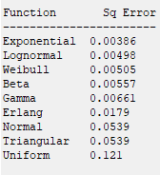
Process Distribution without Subsetting

Slide 22
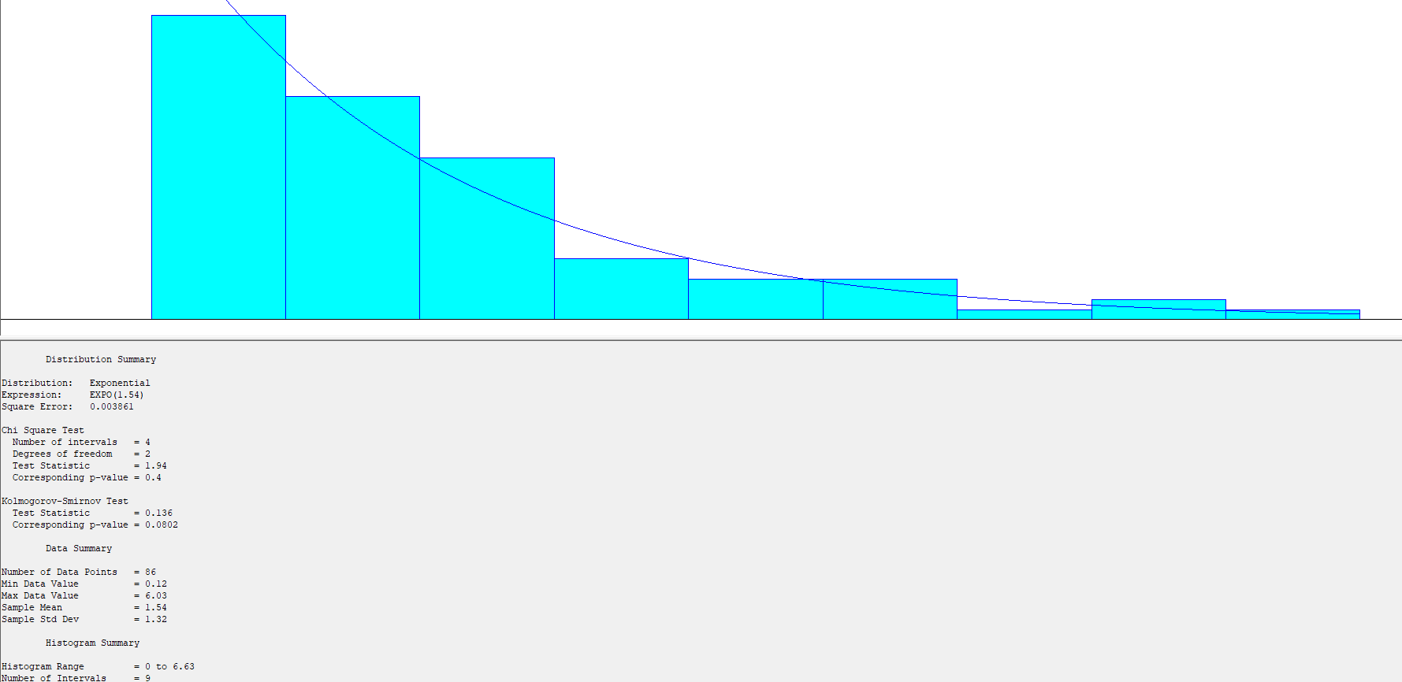
Best Fit in Processing (Exponential)

Slide 23
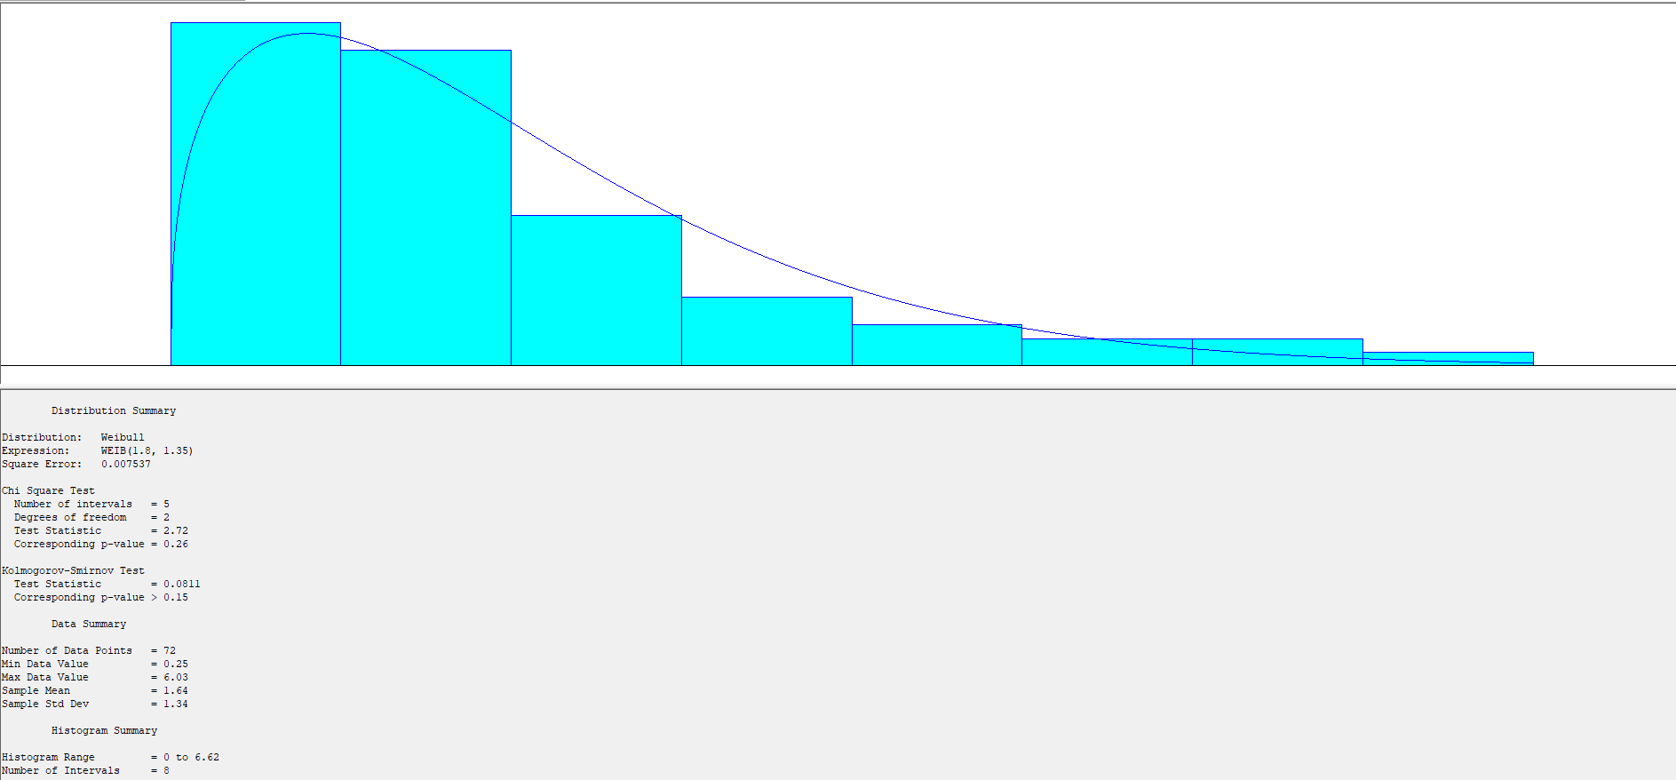



Printing Process

Slide 24
Best Fit in Printing Process (Lognormal)

Slide 25
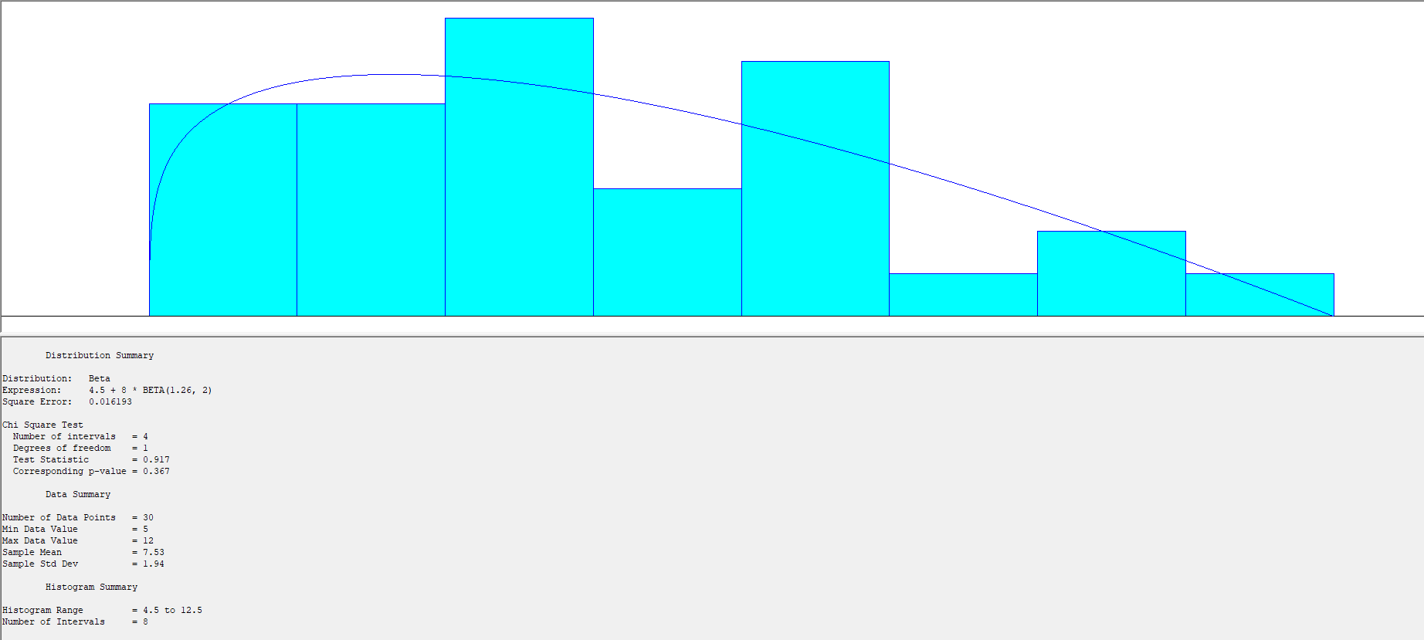
Walking Time
(Beta)

Slide 26
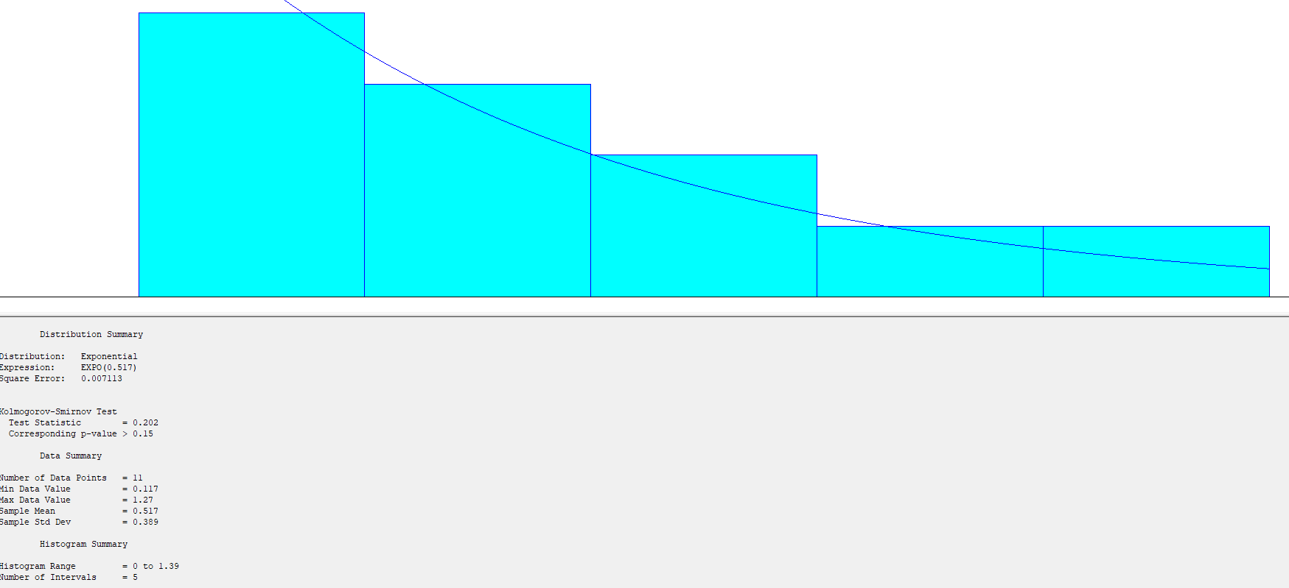

Shopping Process

Slide 27

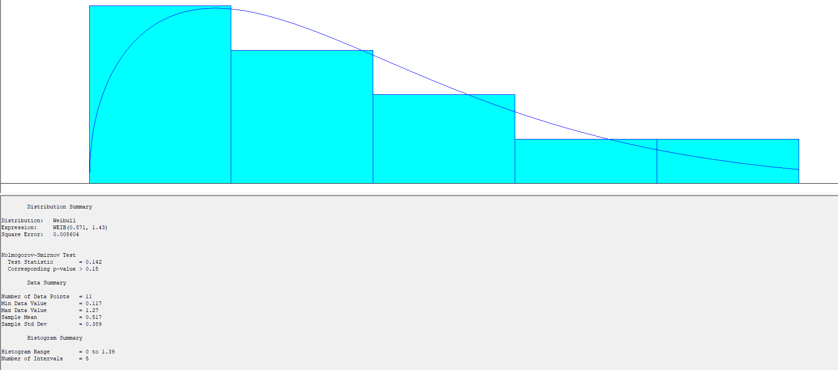

Slide 28

Best Fit in Shopping Process (Beta)

Slide 29
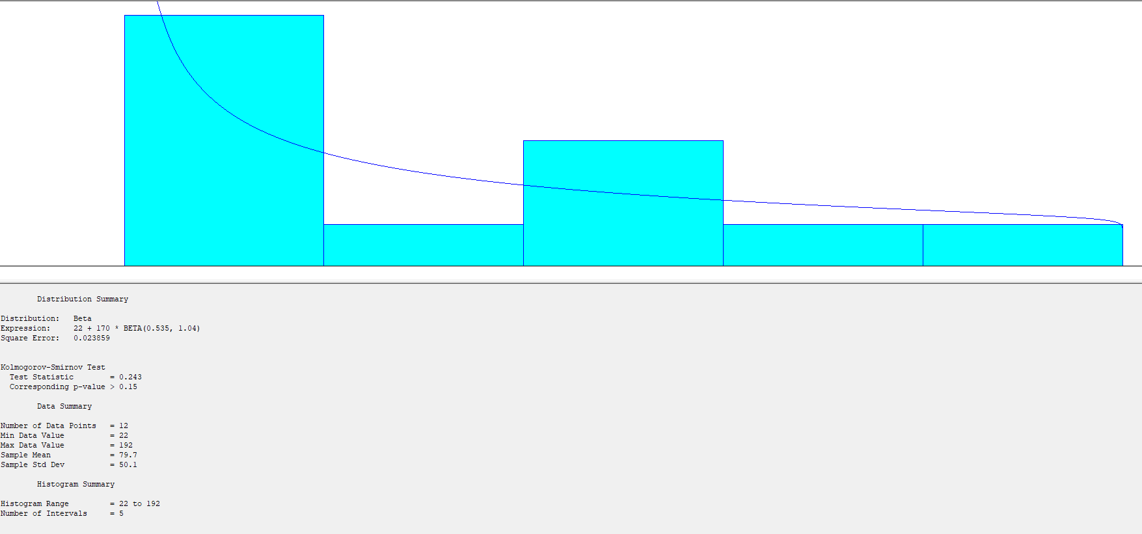
Shopping Time
(Beta)

Slide 30
Table of Contents
02
01
03
04
Student Arrival
Break and Lecture Period Arrival
Data Collection
Process Flow
Data Excel File
Shopping and Printing
Arena Simulation Model

Slide 31
04
Arena Simulation Model

Slide 32
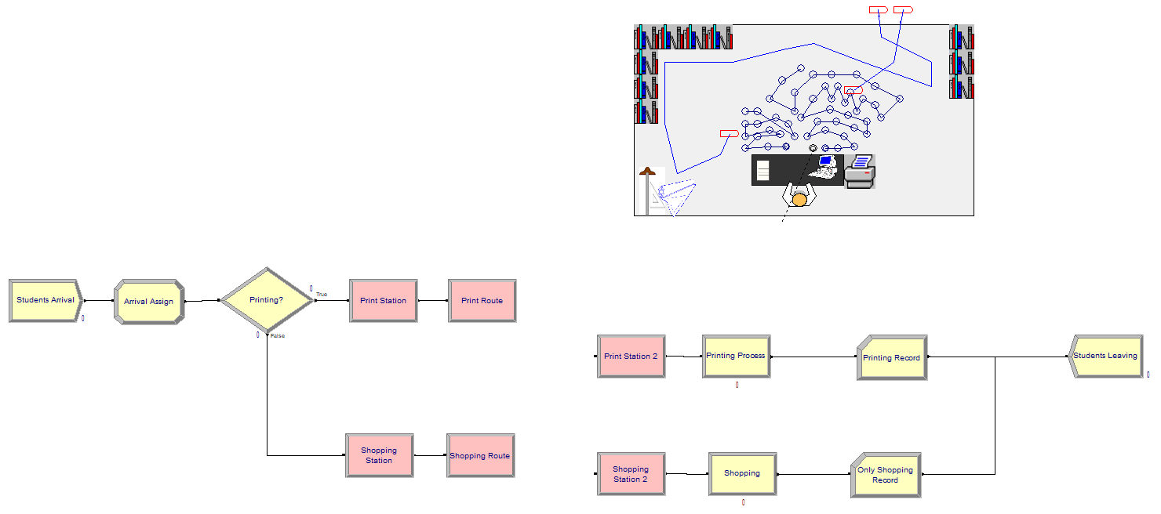
Arena Model

Slide 33
Simulation Assumptions
1. The simulation runs for 20 minutes, with entities processed only during breaks.

Slide 35
Simulation Assumptions
2. Entities are processed using the FIFO method.
3. There are no resource failures.

Slide 36
Simulation Assumptions
4. Processing times are identical for both lectures and breaks.

Slide 37
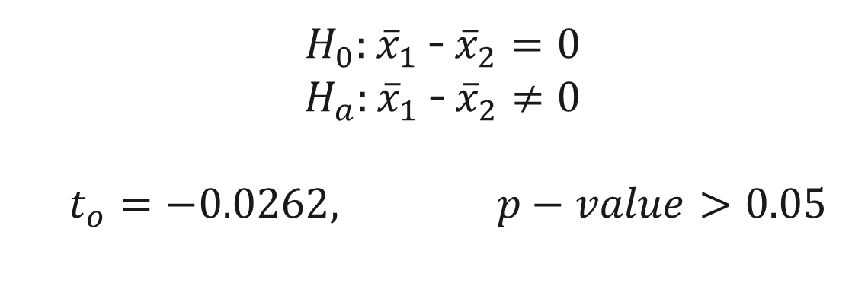
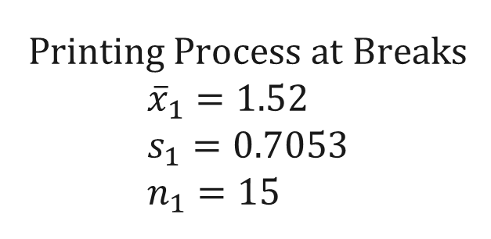
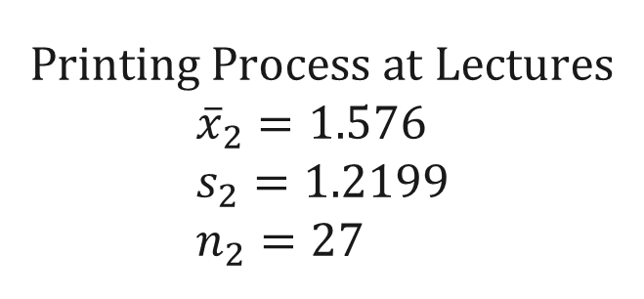
Printing Process at Breaks $${\overline{x}}_{1}=1.52 \\ s_{1}=0.7053 \\ n_{1}=15$$
Printing Process at Lectures $${\overline{x}}_{2}=1.576 \\ s_{2}=1.2199 \\ n_{2}=27$$
$H_{0}:$ ${\overline{x}}_{1}$ - ${\overline{x}}_{2}=0$
$H_{a}:$ ${\overline{x}}_{1}$ - ${\overline{x}}_{2}≠0$
$$t_{o}=−0.0262, p−value>0.05$$

Slide 38
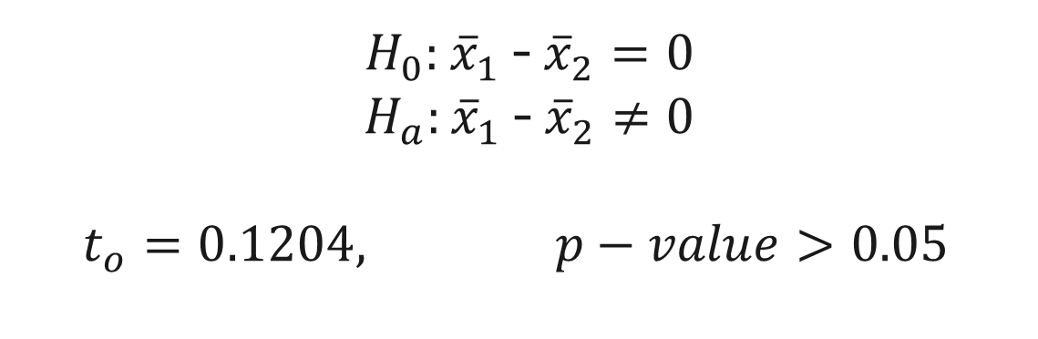
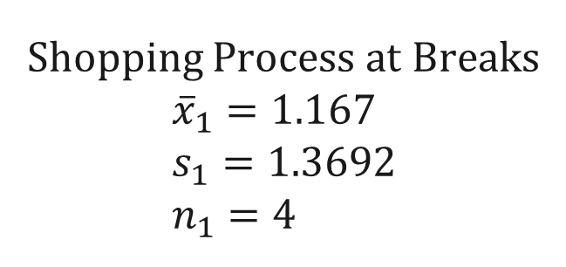
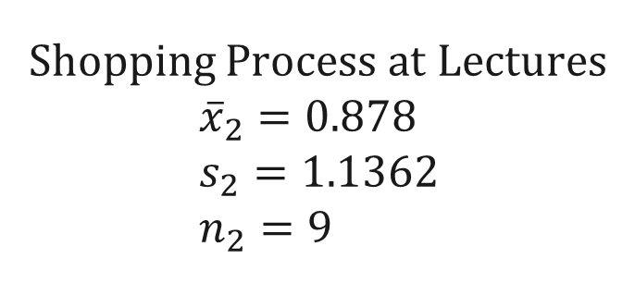
Shopping Process at Breaks $${\overline{x}}_{1}=1.167 \\ s_{1}=1.3692 \\ n_{1}=4$$
Shopping Process at Lectures $${\overline{x}}_{2}=0.878 \\ s_{2}=1.1362 \\ n_{2}=9$$
$H_{0}:$ ${\overline{x}}_{1}$ - ${\overline{x}}_{2}=0$
$H_{a}:$ ${\overline{x}}_{1}$ - ${\overline{x}}_{2}≠0$
$$t_{o}=0.1204, p−value>0.05$$

Slide 39
Simulation Assumptions
5. The printer's availability depends on the employee, and it is not considered a resource.
6. The choice for entities to go shopping or print papers is probabilistic.

Slide 40
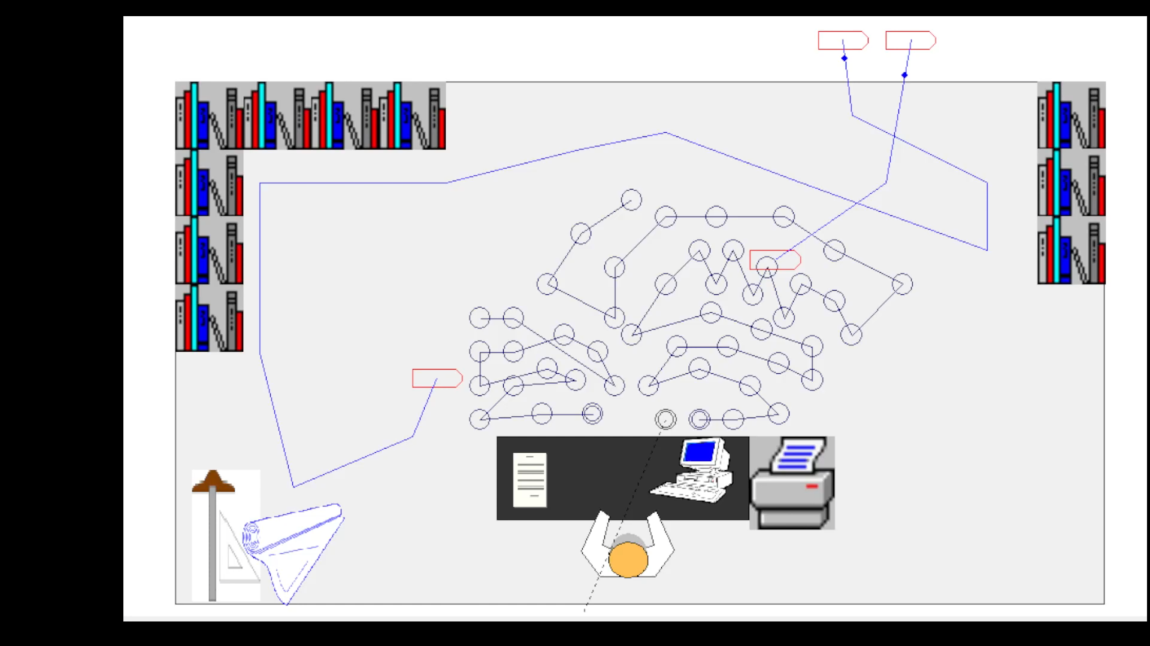

Slide 41
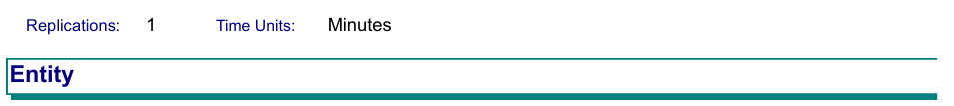
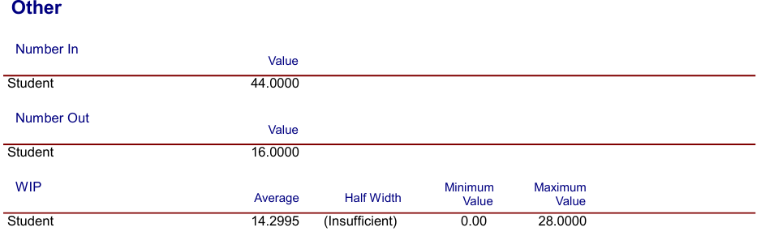
Report Results

Slide 42

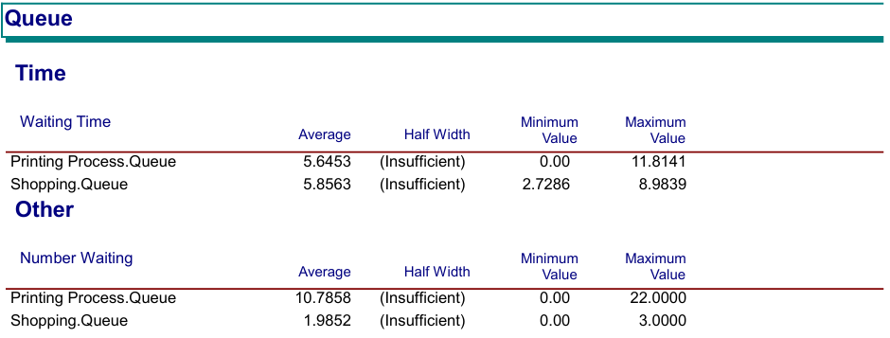

Slide 43
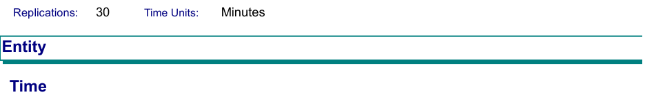
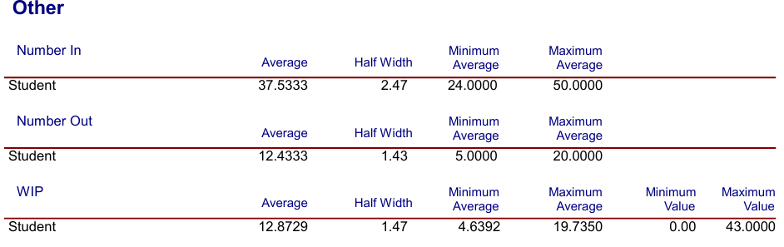

Slide 44
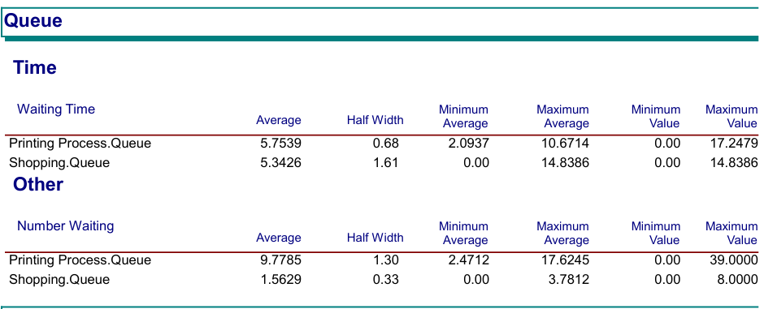

Slide 45
Thank You

